Slide 1
Mini project 2, 2023
Presentation by Haiman

Slide 2
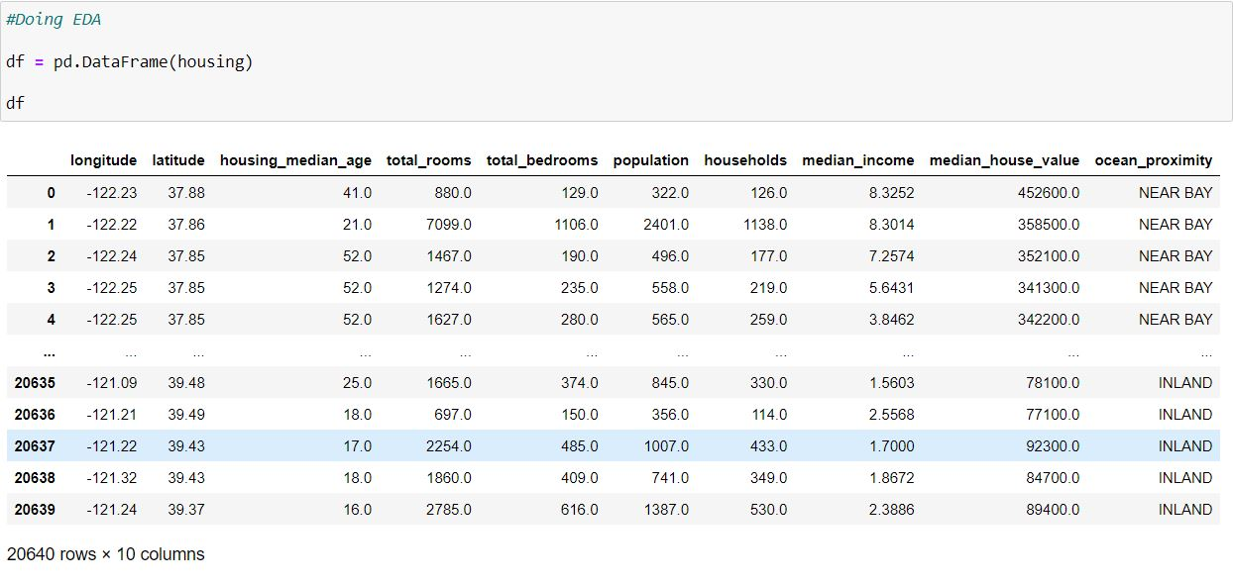
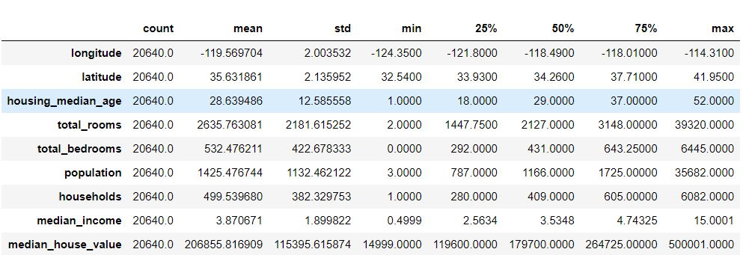
Build a regression model to predict "median_house_value".

Slide 3



Graphs

Slide 4
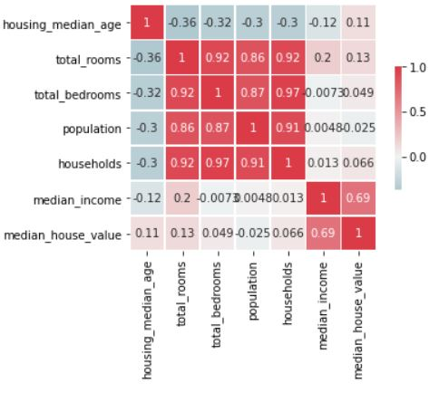
Correlation HeatMap

Slide 5
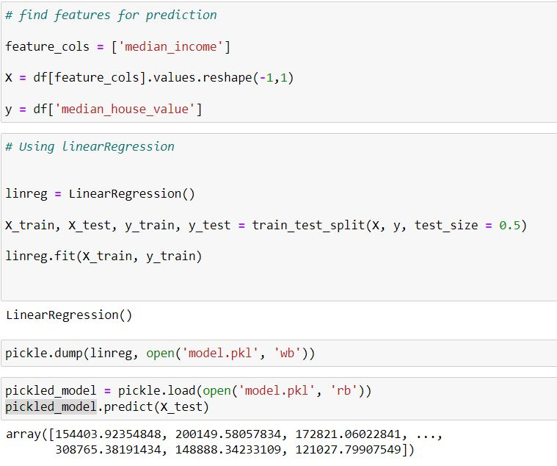
Using Linear Regression

Slide 6
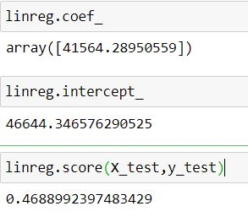
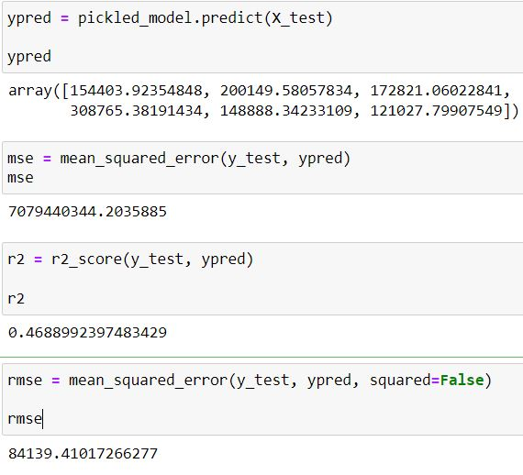
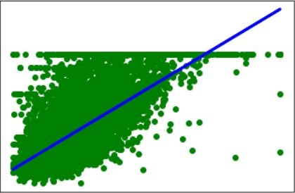
Results

Slide 7
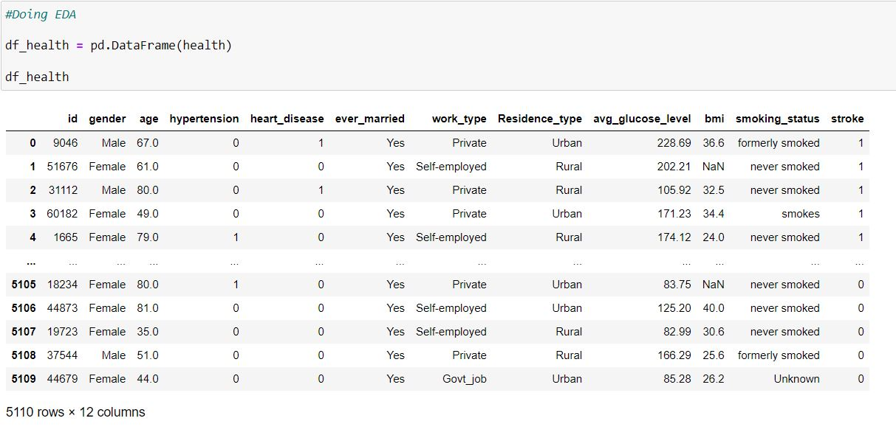
Build a classification model to predict stroke (= 1 if a person had a stroke else 0).

Slide 8



Graphs

Slide 9

Using Logistic Regression

Slide 10
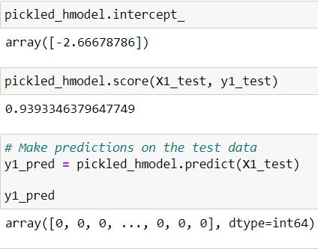
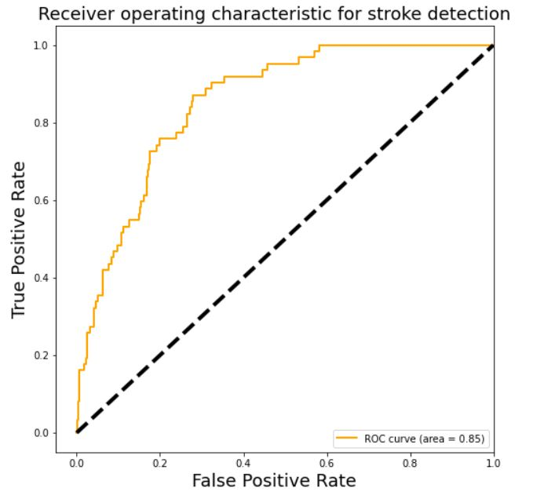
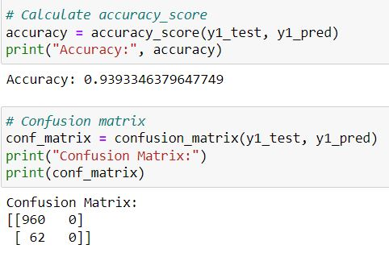
Results

Slide 11
End of Presentation

